Slide 1
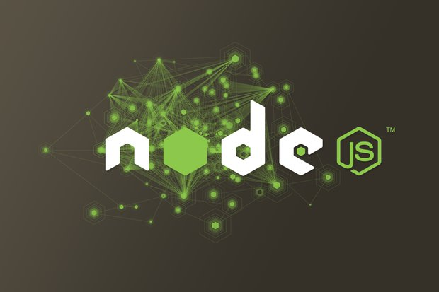

Slide 2

<about-me/>
Studying banking & finance (cbu)
CEO Twishe inc.
Stack: <Nodejs/> <Python/>
I am obsessed with building distributed systems

Slide 3
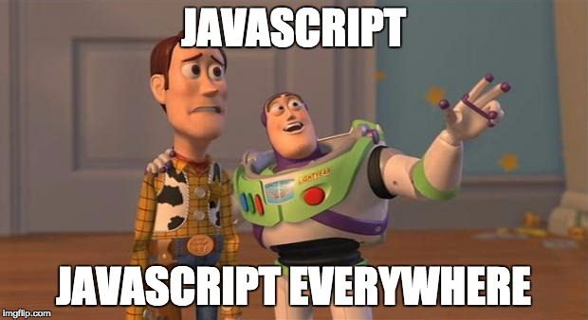
Raise you hand if you code ….

Slide 4
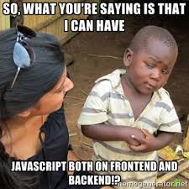

Slide 5
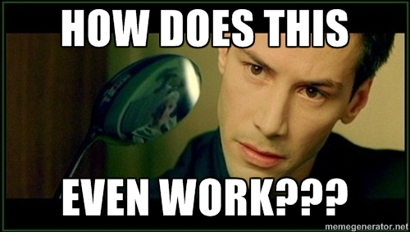
Curious to find out...

Slide 6
Definition...
Node.js® is a JavaScript runtime built on Chrome's V8 JavaScript engine.
Node.js uses an event-driven, non-blocking I/O model that makes it lightweight and efficient.
Node.js’ package ecosystem, npm, is the largest ecosystem of open source libraries in the world.

Slide 7
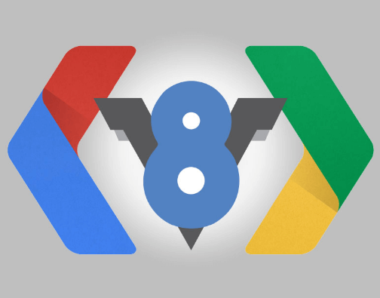
You dont know speed if you dont know...

Slide 8
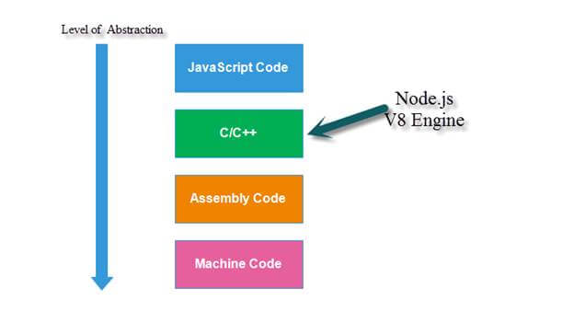
How V8 does it...

Slide 9
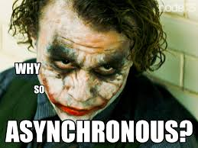
But though...

Slide 10
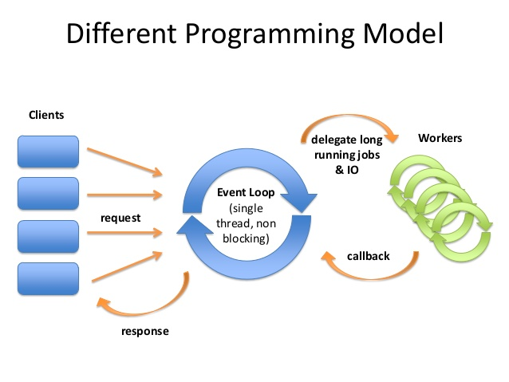
Event-Loop

Slide 11
